Slide 1
Hospital User/Technology Management System
Final Proposal
By: Anassas Anderson and Sam Dominguez

Slide 2
Application Domain - Hospital Management System
Purpose: Allow for hospital staff and administration to easily access information not only on the patient but also with supplies and equipment within the hospital.
Our database will…
Keep track of all patients information such as diagnosis, insurance company and surgeries as well as who is responsible for managing them.
Record the diagnosis, prescribed medicine, and reports given by the doctor to their respective parties.
Organize who is qualified to work on what medical equipment and whether it requires attention.
Notes:
Hospitals have to be able to deal with an array of situations from children stubbing their toe to life threatening diseases that have never been seen before.
In order to run an effective hospital, proper documentation must be done on all patients coming in and out. The documentation would include procedures, medicines, time spent in hospital, and various other.
A hospital also serves as a business for stakeholders who benefit from the services necessary to run a hospital.

Slide 3
Need For Application
Track amount of medicine being supplied to the hospital
Provide centralized location for patient data
Ensure that the appropriate equipment is supplied to each department
Record who works on what equipment as well as who operated on what patient
Makes sure that departments are properly staffed to work on the current number of patients
Manage the workload of the nurses and technicians
Current means of information management include filing cabinets with little to no organization.

Slide 4
Entities
People
Nurses
Doctors
Patients
Technicians
Medical Equipment
Diagnosis
Medicine
Surgery
Prescription
Report
Order
Department
Things
Places
Medical Equipment Company
Insurance
Pharmacy

Slide 5
Relationships
A nurse will work for a specific department, monitor their patients, and assist with surgeries.
The doctor is responsible for generating diagnosis, performing surgery, and prescribing a prescription for his assigned patient. The doctor is also connected to a specific department. They will order for medical technicians to operate medical equipment.
The medical equipment is supplied by a Medical Equipment Company. The medical equipment is used to generate a report. The report will have a status of complete or not attached to when the order was placed.
A pharmaceutical company will be utilized to supply medicine used to fill the prescription.
The patient will receive a diagnosis. Based on the Report, the patient will receive a diagnosis. There services will be insured by an insurance company. The patient will be have surgery operations.

Slide 6
Constraints
Each patient should have one and only one doctor assigned to them as well as one and only one nurse monitoring them.
The patient should also have one and only one insurance provider
Doctors must have at least one patient.
Medical technicians can specialize on one and only one piece of medical equipment and each piece of medical equipment should be operated by no more than three medical technicians.
There can be one and only one doctor performing a surgery and there must be at least one nurse present but only a maximum of four nurses.
Additionally, each of the hospital staff(Doctor, Nurse, Medical Technician) should only be apart of one department.
All primary keys for entities will be unique and non-null

Slide 7
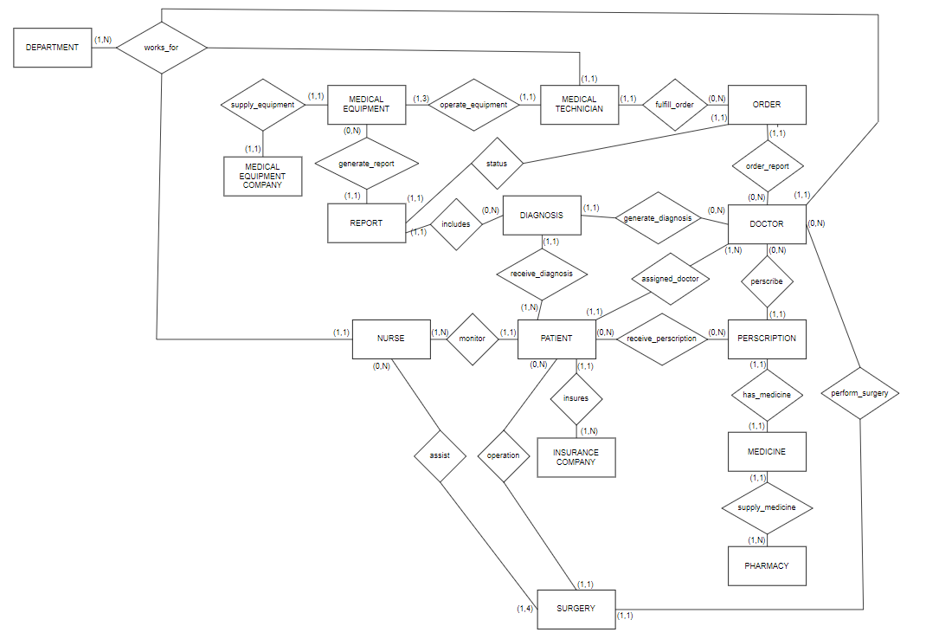
Old ER Diagram

Slide 8
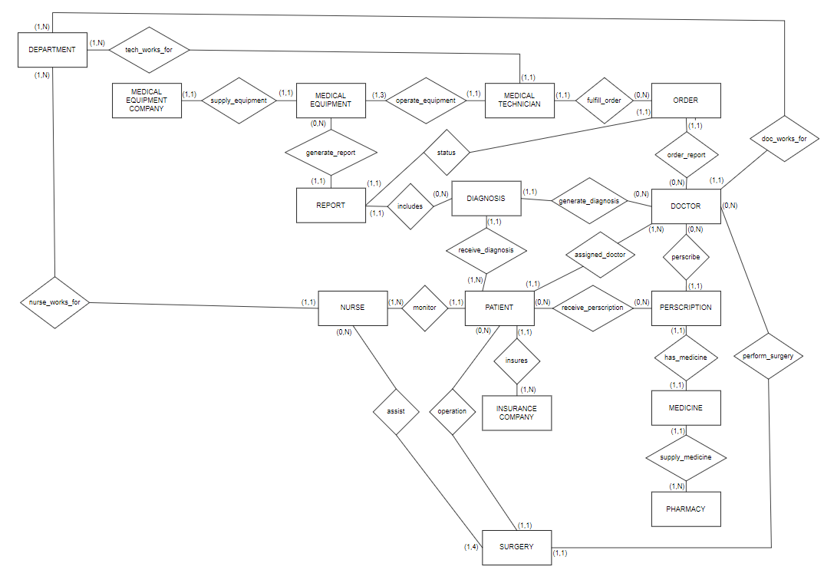
New ER Diagram

Slide 9
Schema
PEOPLE
THINGS
Medical Technician (HOSP_ID, EQUIPMENT_SPECIALTY, EXPERIENCE)
Prescription (PER_ID,REFILLS)
Patient (SSN, NAME, AGE)
Order (ORDER_ID, REQUESTED_SCAN, DATE)
Nurse (HOSP_ID, NAME, EXPERIENCE)
Department (DEPT_NAME, DEP_LOCATION)
Doctor (HOSP_ID, NAME, SPECIALTY, EXPERIENCE)
Surgery (SURGERY_ID, PROCEDURE, OP_TIME, OP_DOCTOR)
PLACES
Diagnosis (DIAG_ID, TREATMENT, RECOVERY_TIME)
Medical Equipment Company (COMP_ NAME, ADDRESS, PHONE_NUMBER)
Report (REPORT_NUM, TEST_SUCCESS, RESULTS)
Insurance Company (INSURANCE_ID, COMPANY_NAME, COST)
Medicine (DRUG_NAME, STOCK_QUANTITY, EXPIRATION_DATE)
Pharmacy (COMP_NAME, ADDRESS, PHONE_NUMBER)
Medical Equipment (PART_NUM, COST)

Slide 10
BCNF
Functional Dependencies:
{PER_ID → REFILLS}
{ORDER_ID → REQUESTED_SCAN, DATE
{DEPT_NAME → DEP_LOCATION}
{SURGERY_ID → PROCEDURE, OP_TIME, OP_DOCTOR}
{DIAG_ID → TREATMENT, RECOVERY_TIME}
{REPORT_NUM→ TEST_SUCCESS, RESULTS}
{DRUG_NAME → STOCK_QUANTITY, EXPIRATION_DATE}
{PART_NUM → COST, EQUIPMENT_NAME}
{HOSP_ID → EQUIPMENT_SPECIALTY, EXPERIENCE}
{SSN→ NAME, AGE}
{HOSP_ID → NAME, EXPERIENCE}
{HOSP_ID → NAME, SPECIALTY, EXPERIENCE}
{COMP_NAME → ADDRESS, PHONE_NUMBER}
{INSURANCE_ID → COMPANY_NAME, COST}
{COMP_NAME → ADDRESS, PHONE_NUMBER}

Slide 11
BCNF (Continued)
1NF: no multivalued attributes → SATISFIED
2NF: no partial dependencies → SATISFIED
3NF: no transitivity → SATISFIED
BCNF: every determinant is a candidate key → SATISFIED

Slide 12
TRIGGERS
When a patient is deleted, they will also be removed from the relationship table linking them to a nurse and their assigned doctor.
DELIMITER $$
CREATE TRIGGER INSURED_CHECK
BEFORE INSERT ON INSURES
FOR EACH ROW
BEGIN
declare msg varchar(255);
IF NEW.INSURANCE_ID NOT IN (
SELECT I.INSURANCE_ID
FROM insurance_company I
) THEN
SET MSG = 'INSURANCE PLAN NOT SUPPORTED';
SIGNAL SQLSTATE '45000' SET MESSAGE_TEXT = MSG;
END IF;
END;
$$
DELIMITER ;

Slide 13
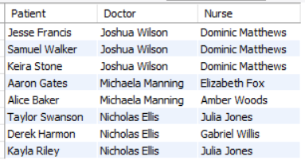
View
The view seen below returns all patients and the medical staff(nurse and doctor) that are assigned to them.
Select * from patientstaff;

Slide 14
Acknowledgements
Anassas Anderson
Created SQL commands to make entity tables and data
Created trigger for database
Finalized presentation slides
Samuel Dominguez
Created SQL commands to make relational tables and data
Created view for the database
Created sql queries for demo

